Slide 1
Introduction to Data Science

Slide 2
Source of data

Slide 3
Source of data?
The following are the two sources of data:
Primary data
Secondary data

Slide 4
Source of data?
1. Primary Data
These are first-hand information collected by an investigator. The data collected are pure and original and collected for a specific purpose. This type of data has never undergone any data preprocessing before. For example, population census conducted by the government of Kenya after every 10 years.

Slide 5
Source of data?
2. Secondary data
Secondary data refers to second-hand information. They are data acquired from optional sources like magazines, books, documents, journals, reports, the web and more. That is, they are not originally collected rather obtained from already published or unpublished sources. Secondary data are pure in the sense that they have undergone data preprocessing at least once.

Slide 6
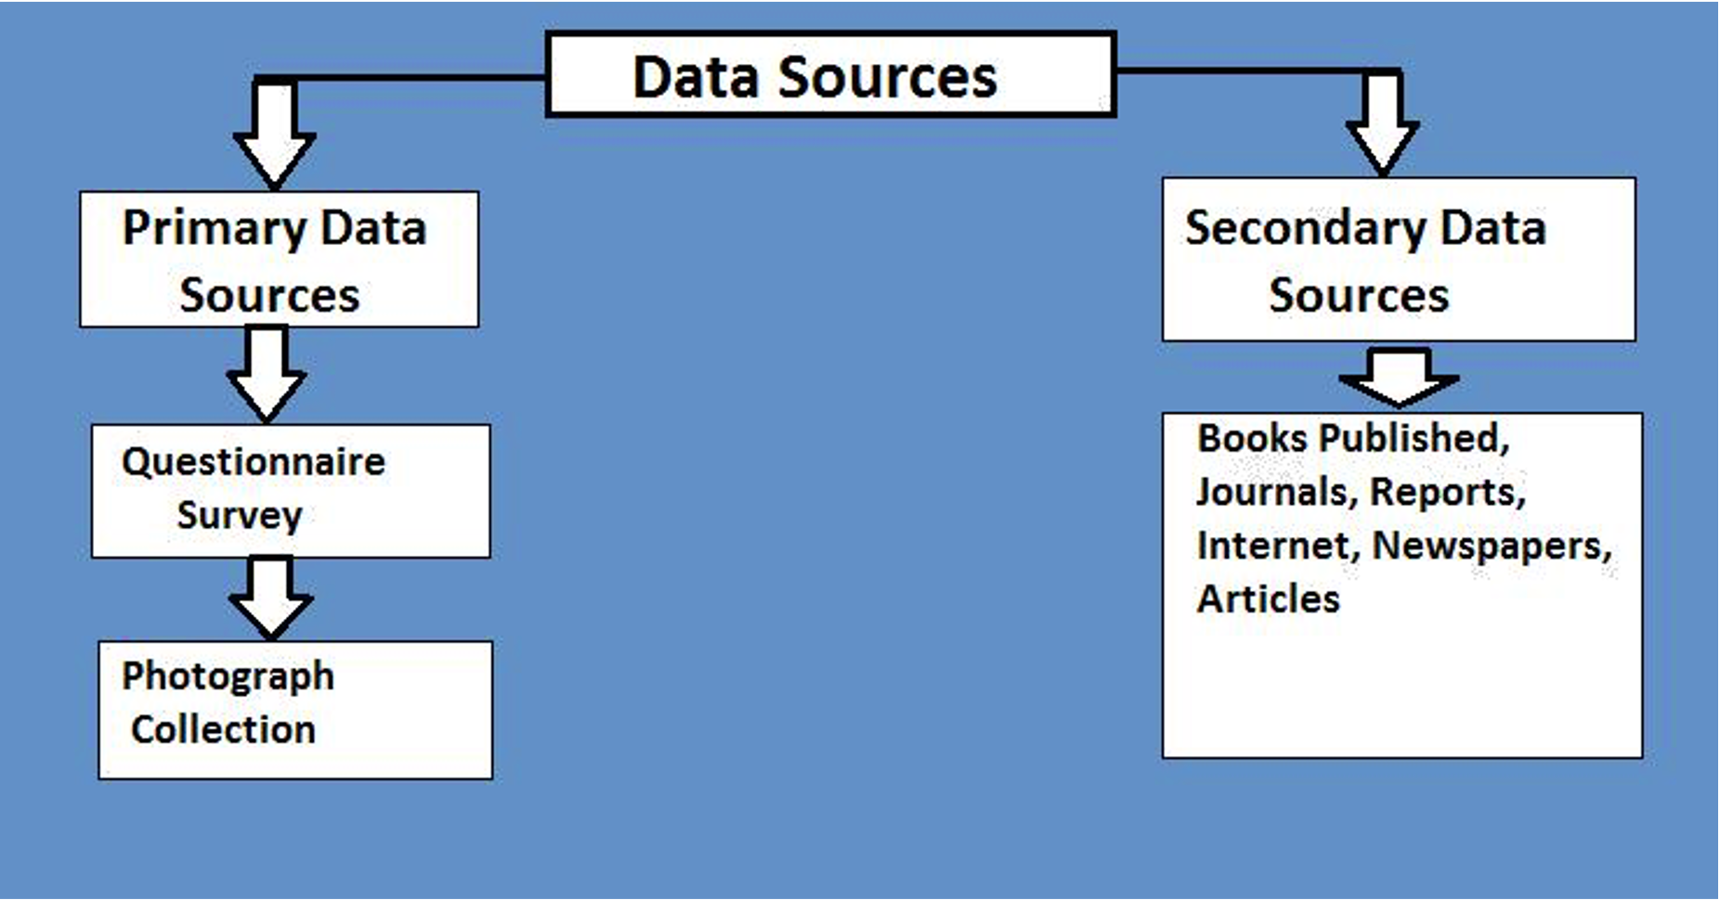
Summary

Slide 7


